Slide 1

FERTILIZER COMPANY AUTHENTICATION ON ETHEREUM PLATFORM
Batch No: 5 Project Guide:
VENKATA NIKHILA.K (174G1A05B0) .Dr.G.K.Venkata Narasimha Reddy, M.Tech,Ph.D
TEJASWINI.N (174G1A0599) Professor `
VAMSHI KASYAP.S (174G1A05A5)
SAI NARASIMHA REDDY.K (174G1A0569)
Srinivasa Ramanujan Institute of Technology
Department of Computer Science & Engineering

Slide 2
Introduction
The main purpose of fertilizer company authentication is to make sure that the fertilizers from authentic companies should only reach customers.
In order to achieve our objective we are making use of Ethereum platform in which every event which performs write operation can be considered as “PROGRAMMED TRANSACTION”.
We are using decentralized application deployed on Ethereum Public Blockchain.
In order to verify the fertilizer companies which are selling genuine fertilizers.Authentication of fertilizer companies is required.

Slide 3
Existing system
In traditional Fertilizer Company Authentication system there is a chance of manipulating the database which contain Authentic Fertilizer Companies.
The manipulation of the database which contains Authentic Fertilizer Companies without tracking the activity happening during manipulation will in turn deteriorate the trust on the system.
The proof of existence of certain value at certain point time can not be proved in the traditional system.

Slide 4
Proposed System
The Big difference that our Fertilizer Authentication Dapp can bring is it will takes the transparency to the next level.
The each and every operation performed in Dapp will be called as “TRANSACTION” and this transaction will get recorded.
These transactions will gets stored on Ethereum Blockchain and if we store data data on blockchain it cannot be manipulated at any cost.if we want to remove the data the data on Blockchain it can be done by “COMPENSATING TRANSACTION”.

Slide 5
Abstract
Decentralized applications are the type of application that are operated in the decentralized environment in the absence of central Server.
Authentication of fertilizer companies is very important in order verify the companies which are selling genuine fertilizers.
We are using a decentralized application deployed on Rinkeby test network of Ethereum .A smart contract written in solidity language by taking help of External account deployed on to internal node present in Rinkeby test network.

Slide 6
Continued..
The node which deployed the smart contract had got access to register and delete the companies from Blockchain database based on the feedback provided which was given based on to factors they are Fertilizer Effect and the other one is weather.
The Access of functions like registering companies and deleting the companies has been implemented by explicitly implementing a user defined modifier.
The Application Binary Interface can be used for interaction between smart contract and javascript.

Slide 7
Problem Statement
In these days farmers are facing lot of issues with fertilizers companies who are producing fertilizers with low quality.The usage of these type of fertilizers will affect the farmer financially.
Fertilizer plays an important role in the cultivation of crops.so making sure that the fertilizers Companies which produce fertilizers were of good quality is a challenging task.
The major problem faced by the farmers is that the Fertilizer companies pretend to behave like they are producing Fertilizers of good quality.

Slide 8
Module Description
Authentication Authority Module:
Authentication Authority will deploy the smart contact on to the Rinkeby test network which is one of the test network of Ethereum Blockchain.
Authentication Authority will register the companies on to the Blockchain database.
Authentication Authority has got privileges to discard the companies on the Blockchain on the basis of the feedback provided by the Authenticator.

Slide 9
Continued..
Authenticator Module:
Authenticator Module will input the fertilizer company name and Authenticates whether the fertilizer Company from which fertilizer selected to buy by the farmer exists in the Blockchain or not.
Authenticator module will also provide feedback that feedback is provided by taking the climatic conditions and the effect of the fertilizer in to consideration.

Slide 10
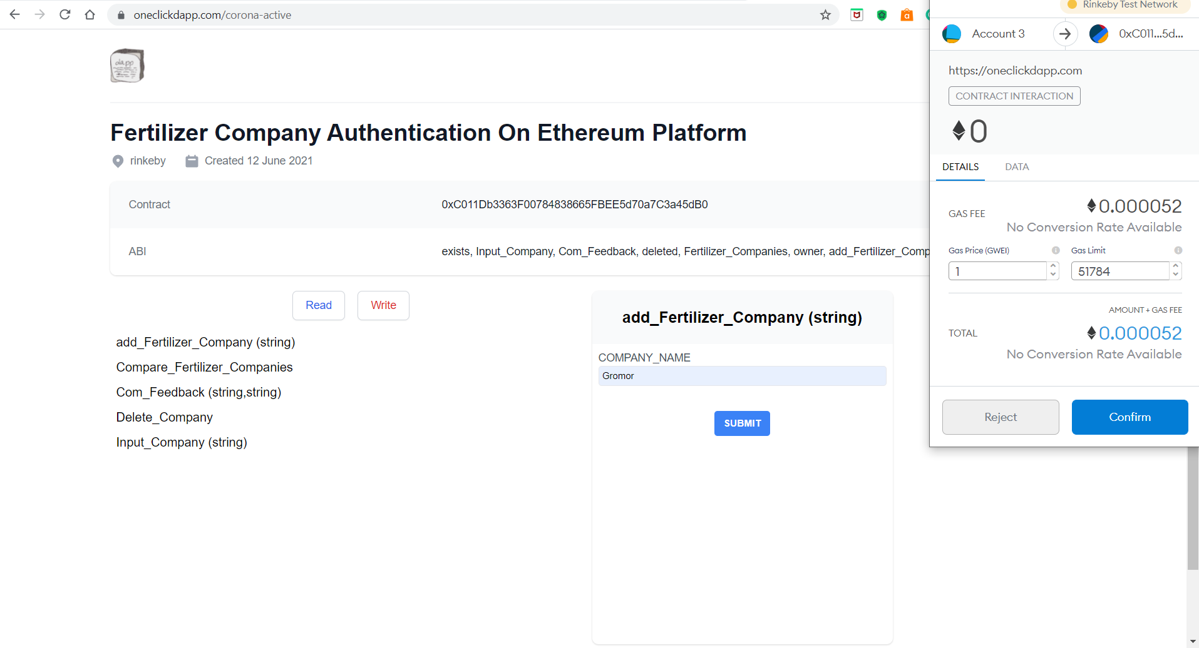
Outputs
Registering Fertilizer Companies:

Slide 11
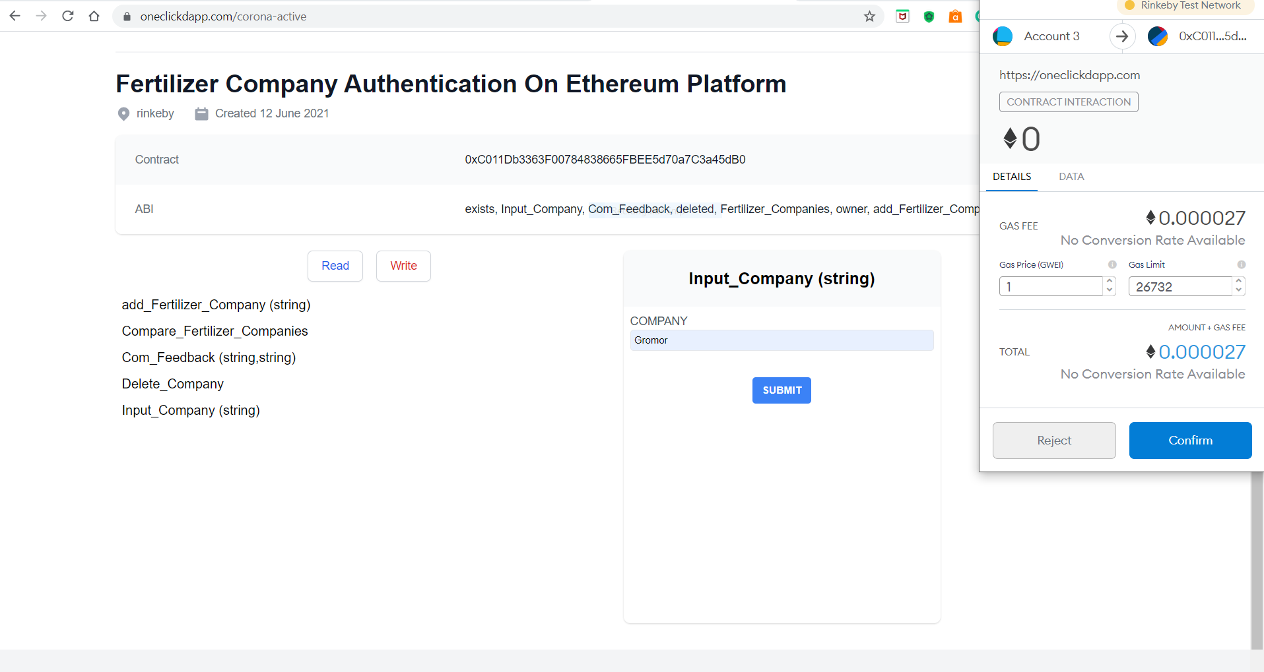
Giving Input for Authentication:

Slide 12
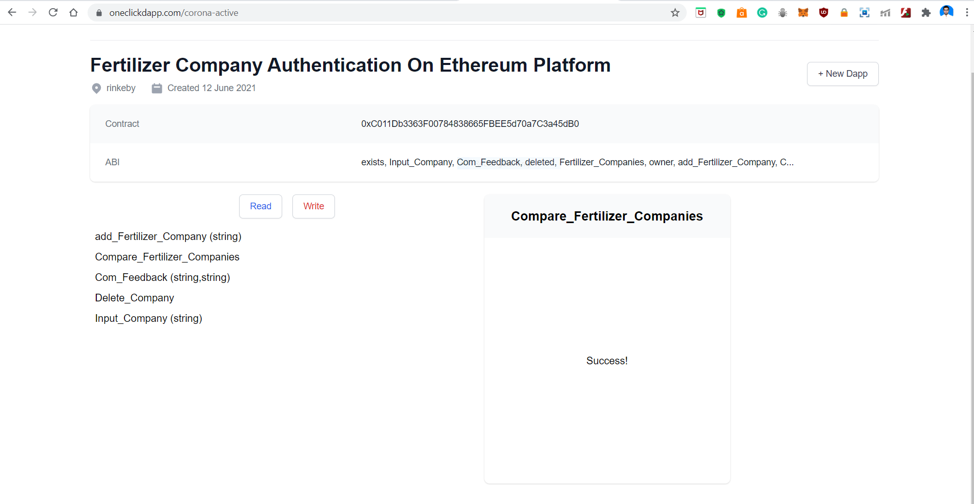
Authenticating Fertilizer Companies:

Slide 13
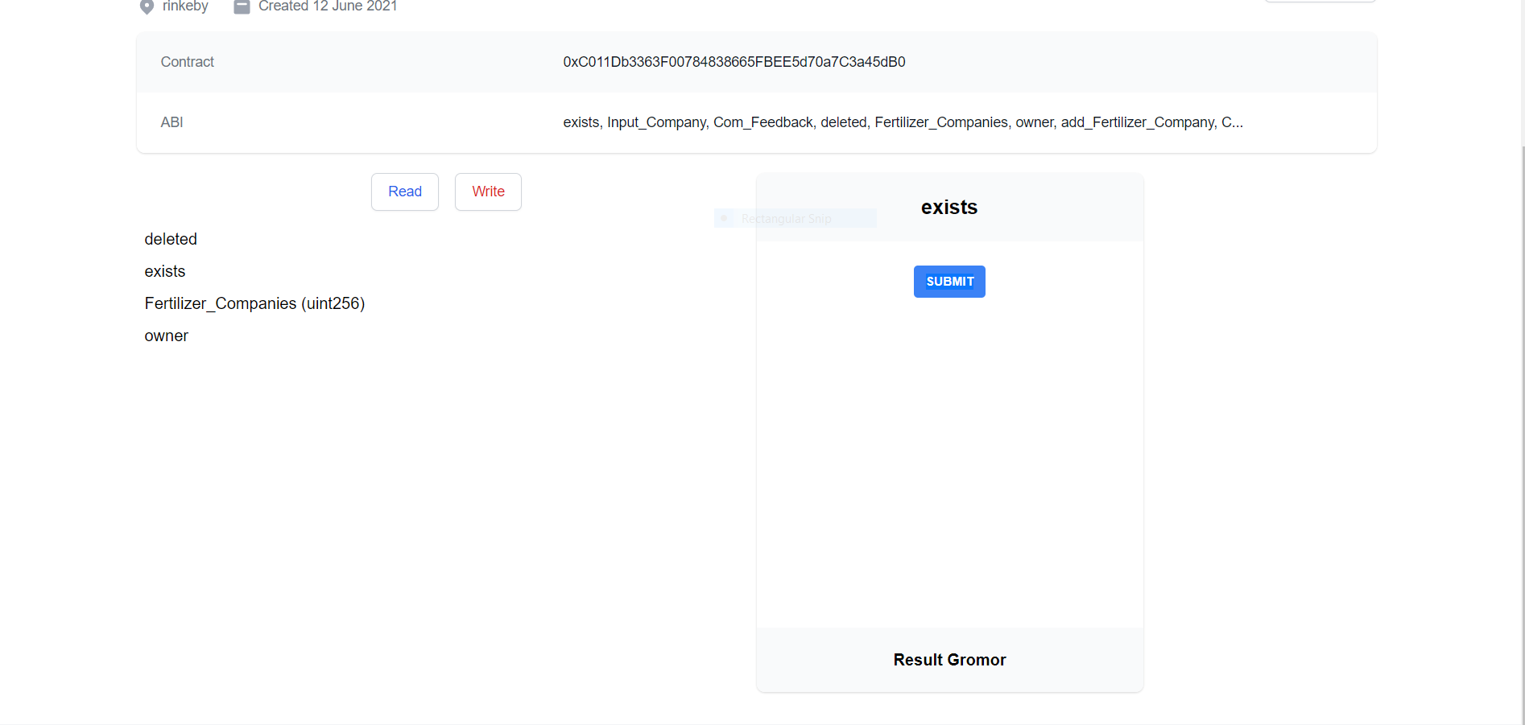
Continued..

Slide 14
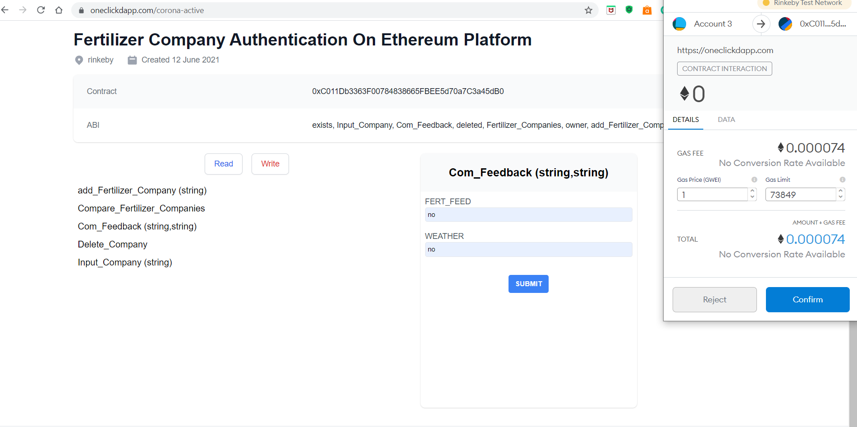
Giving feedback:

Slide 15
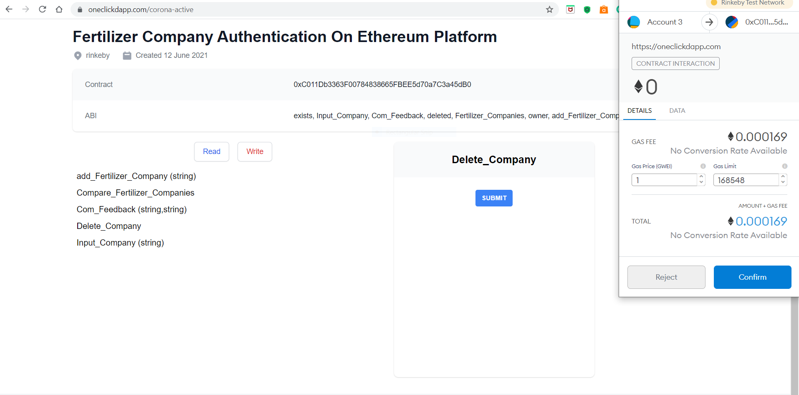
Deleting the Fertilizer company based on Feedback:

Slide 16
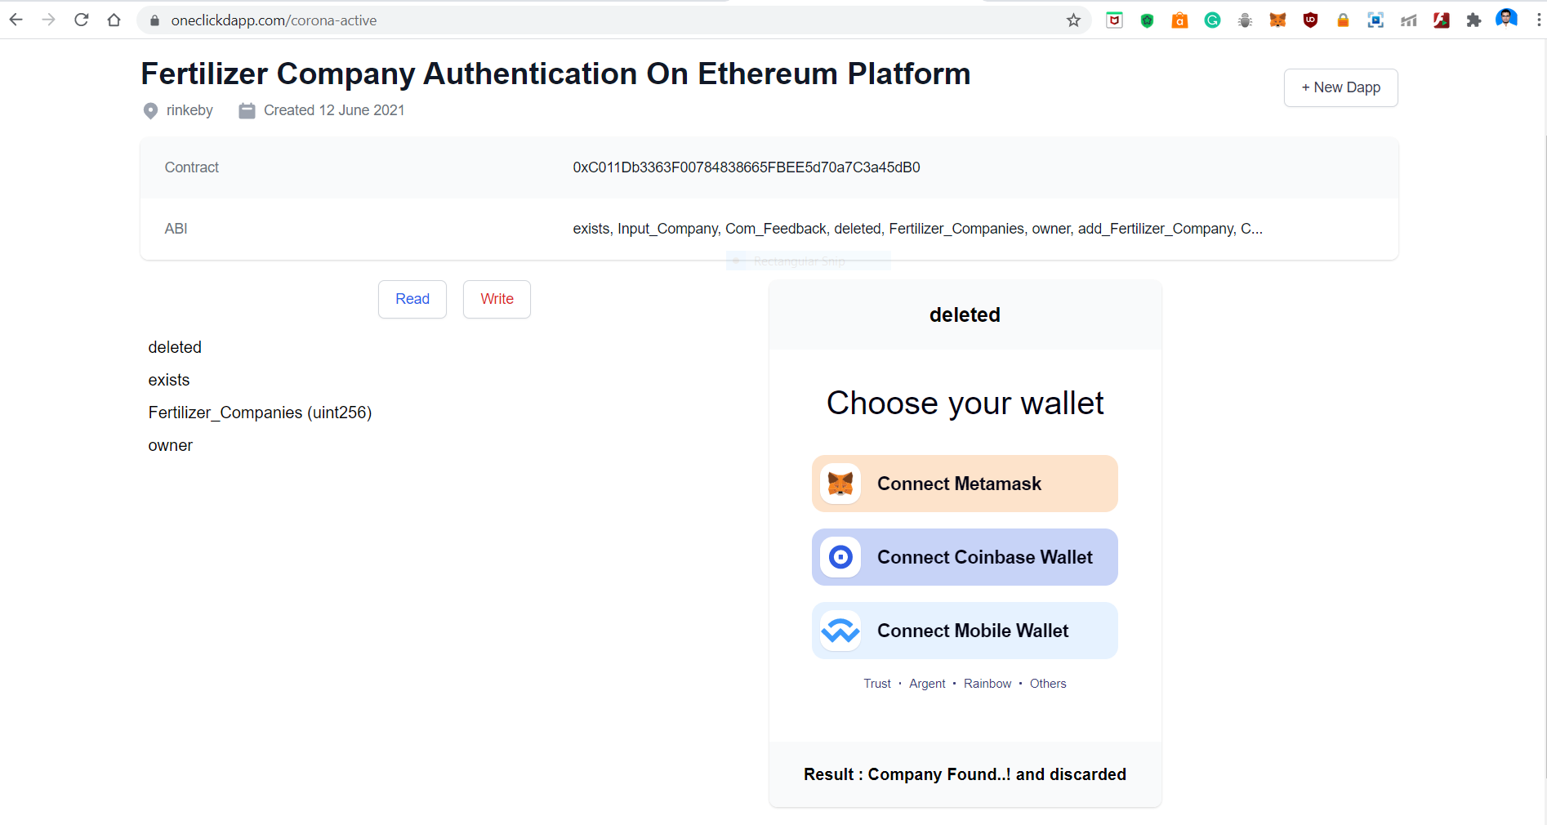
Status Of Deletion Operation:

Slide 17
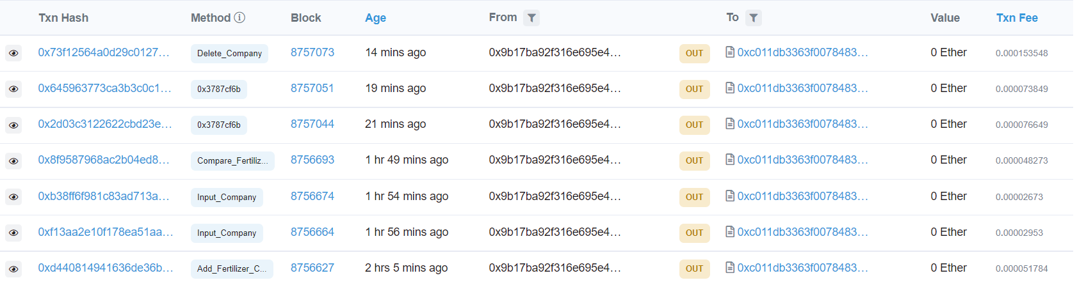
Transactions Recorded On Ethereum Rinkeby network:

Slide 18
Summary
The system will create the opportunity where the farmer can find a reasonable and trustable system which will make the availability of fertilizers from trusted companies.
We describe our abstract system with a proposed architecture and workflow to describe the secured access control and distribution management.
Moreover, the user will have trust in the system as it uses smart contract features which confirm data privacy and security.

Slide 19
References:
[1] Dr.V.K.Saraswat, Dr.Bimal Kumar Roy and C P Gurnani,
Blockchain Technology Concepts and Applications.
[2] Robert Infante and Thomas Bertani, Building Ethereum Dapps.
[3] https://www.dappuniversity.com/
[4] Sabbir Ahmed, Md.Tarif Hosen, Md. Ezazul Islam,Md. Hasibul Haan, Blockchain based Fertilizer Distribution System : Bangladesh Perspective

Slide 20
Queries
??..
THANK YOU.

